Slide 1
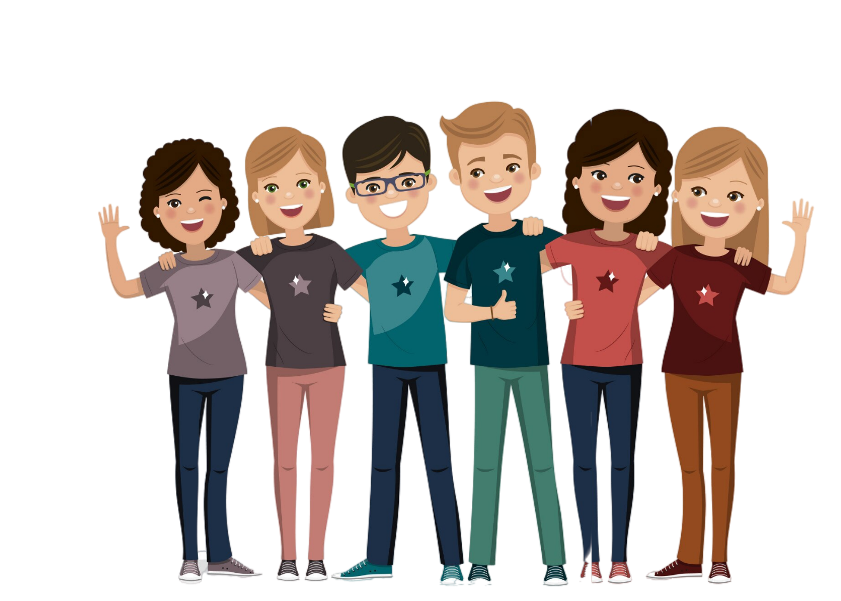


WHAT IS FRIENDSHIP?
Friendships are bonds between two or more people who want to engage with one another

Slide 2
WHAT MAKES A FRIEND SPECIAL FOR YOU?
If someone is loyal to you, honest with you, shares many of your interests, and is there for you when you need them, you would likely consider them a friend.

Slide 3
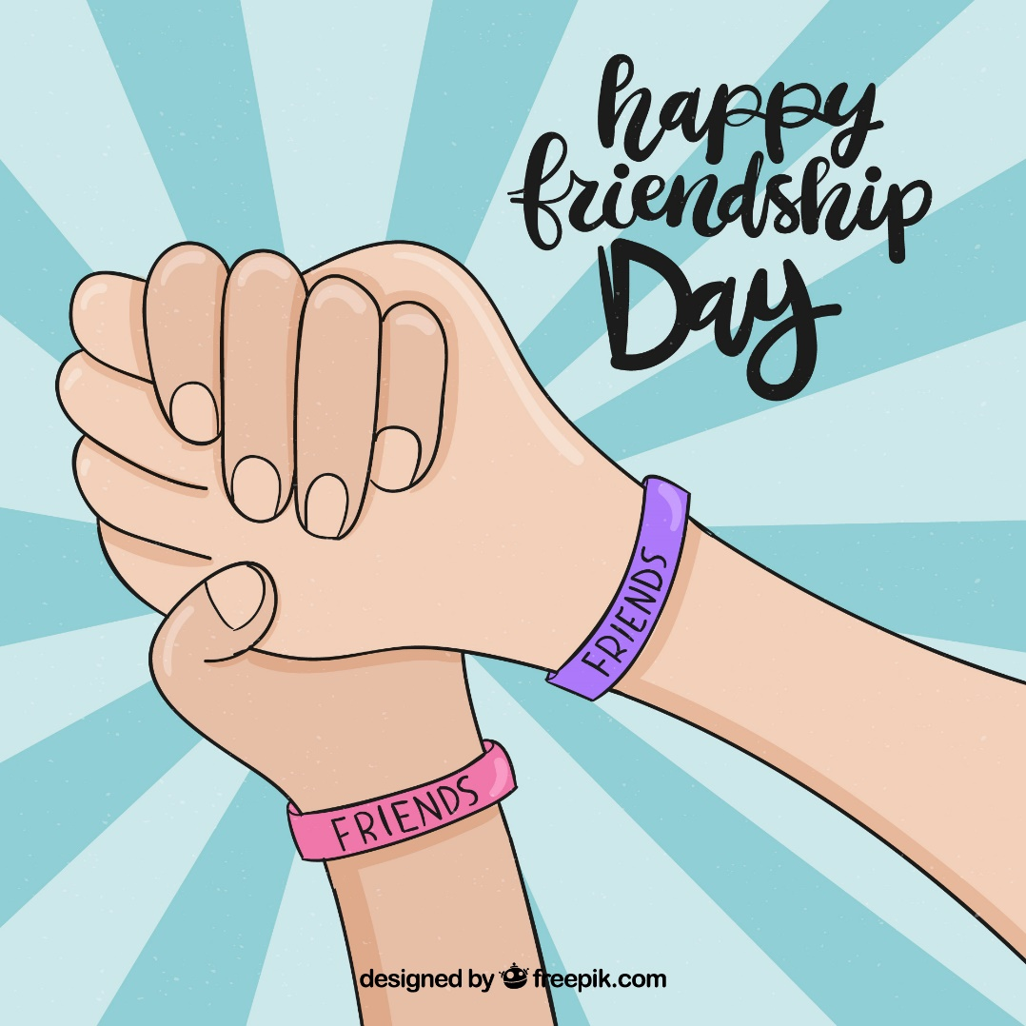


Slide 4
WHAT DO YOUTHINK ABOUT FRIENDSHIP?
TELL US YOUR OPINION

Slide 5
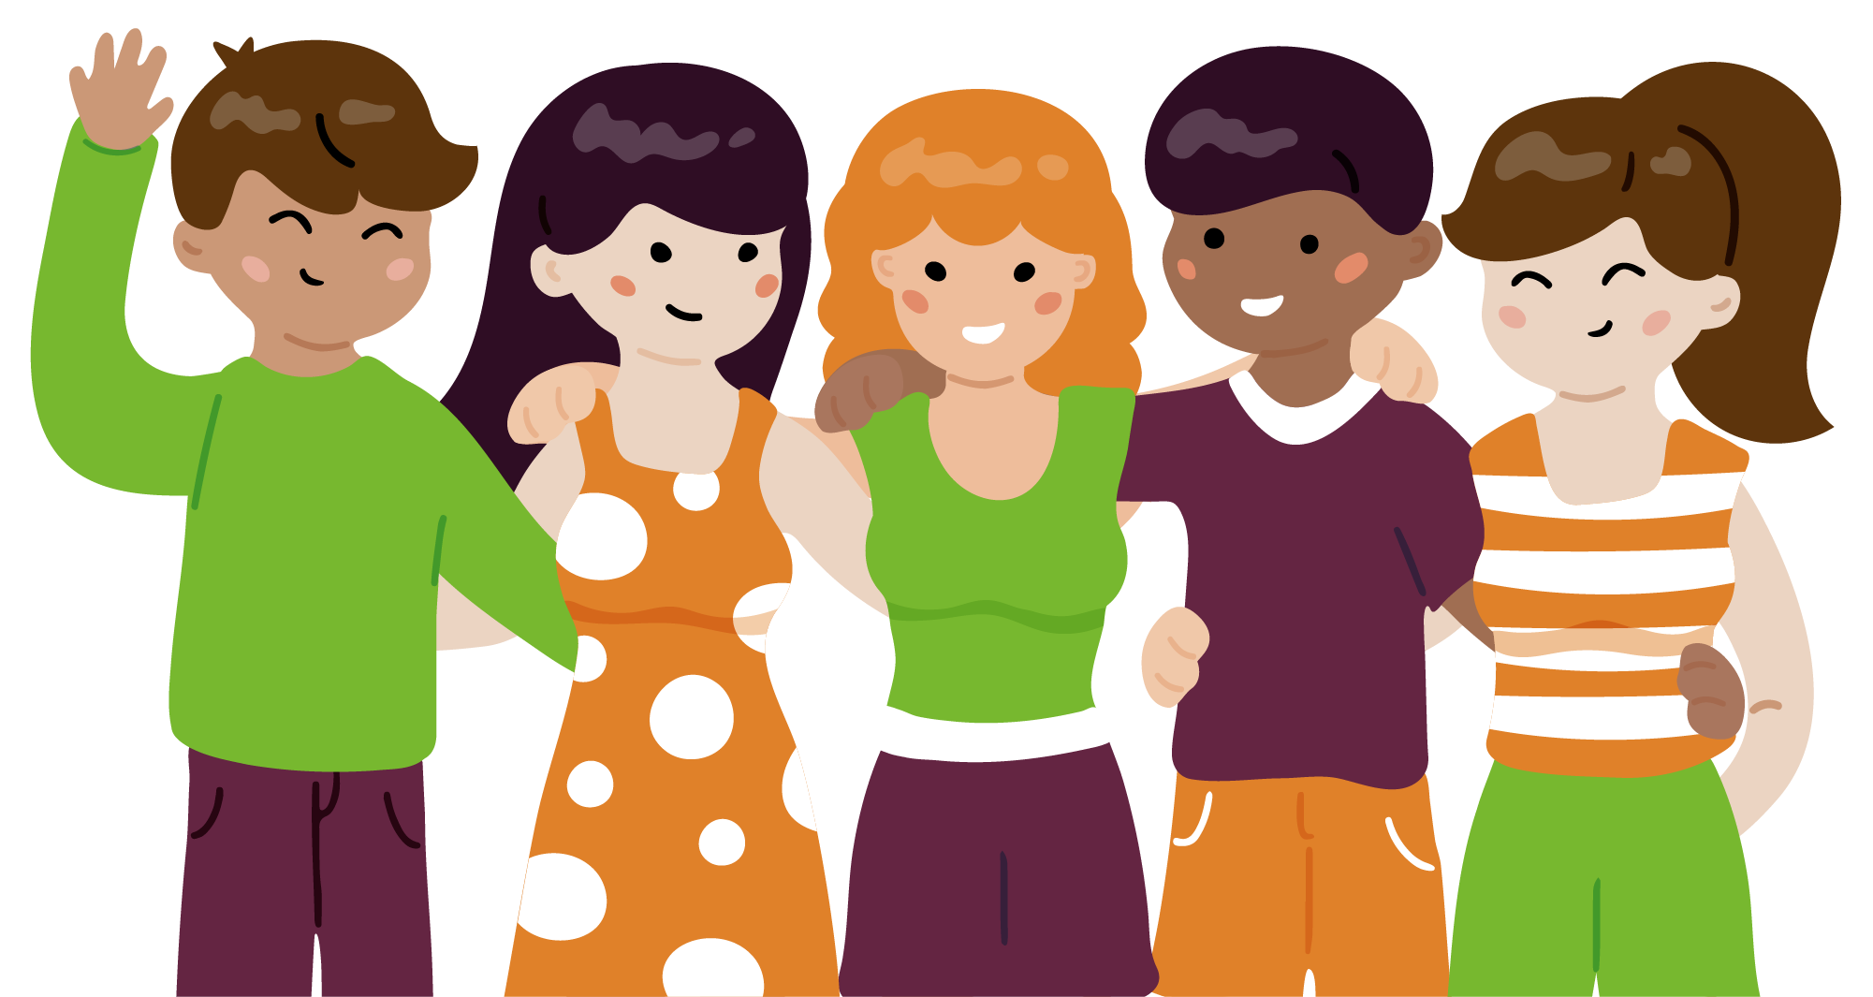

Slide 6
YOU MAY HAVE FRIENDS ALL OVER THE WORLD IF YOU JUST CARE ABOUT THE CHARACTER OF A PERSON

Slide 7
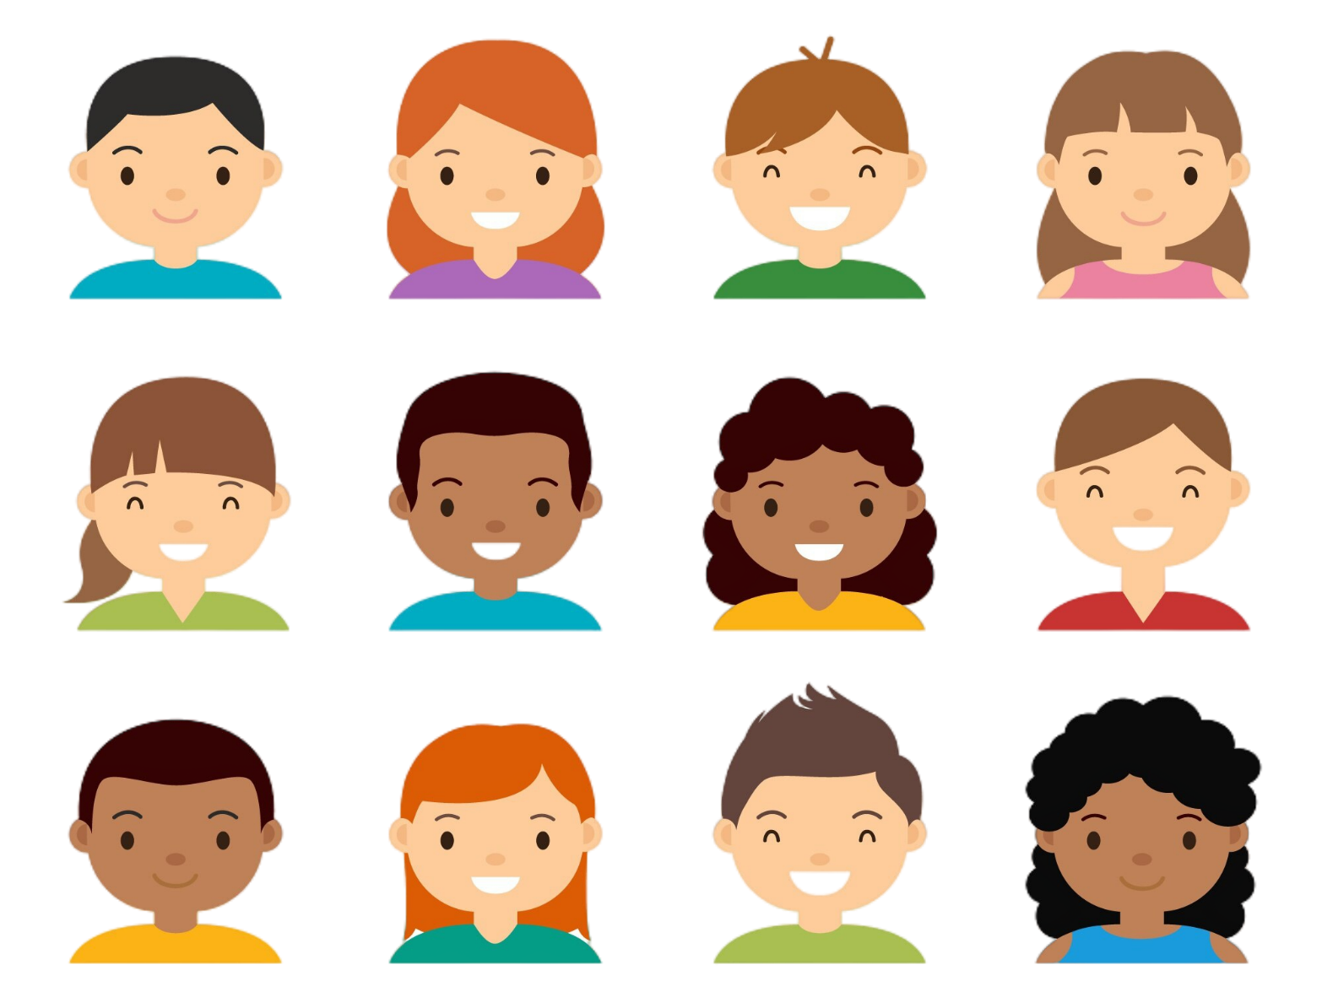
FRIENDSHIP

Slide 8




Module: Civic awareness
Sub-module: Valuing diversity
Topic: Embracing Diversity in Friendship
Resource title: Friendship
Credits: APDNE
2023-1-BG01-KA220-SCH-000160813
All media are within the EU intellectual property law.
Funded by the European Union. Views and opinions expressed are however those of the author(s) only and do not necessarily reflect those of the European Union or the European Education and Culture Executive Agency (EACEA). Neither the European Union nor EACEA can be held responsible for them.

